Slide 1
Introduction to Testing
Emp Id-6162

Slide 2
SoftwareTesting
Testing is a method to check whether the actual software product matches expected requirements and to ensure that software product is Defect free.

Slide 3
Types of Testing
Manual Testing
Automation Testing

Slide 4
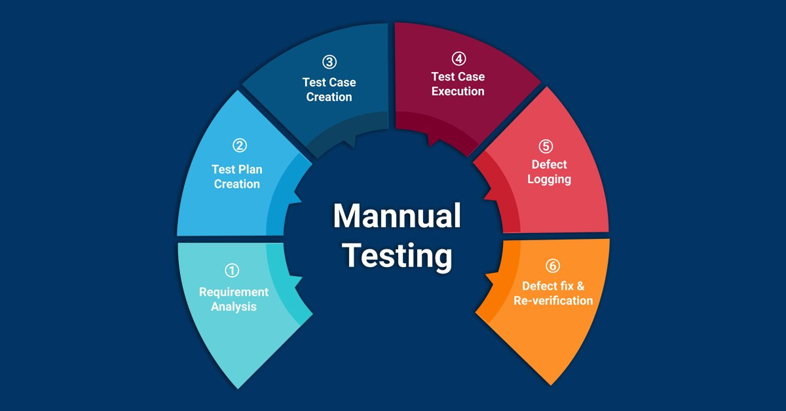
Manual Testing

Slide 5
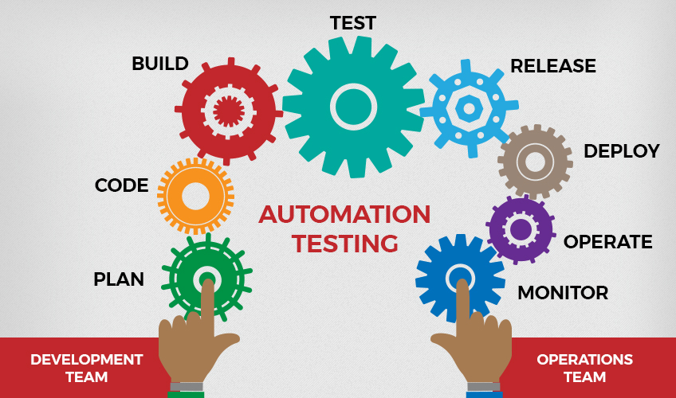
Automation Testing

Slide 6
Techniques of Software Testing
Black Box Testing
White Box Testing

Slide 7
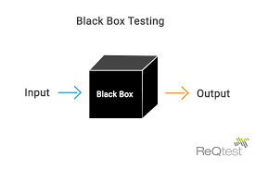
Black Box Testing

Slide 8
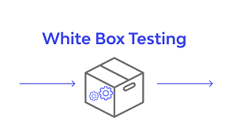
White Box Testing

Slide 9
Levels of Testing
Unit Testing
Integration Testing
System Testing
Acceptance Testing

Slide 10
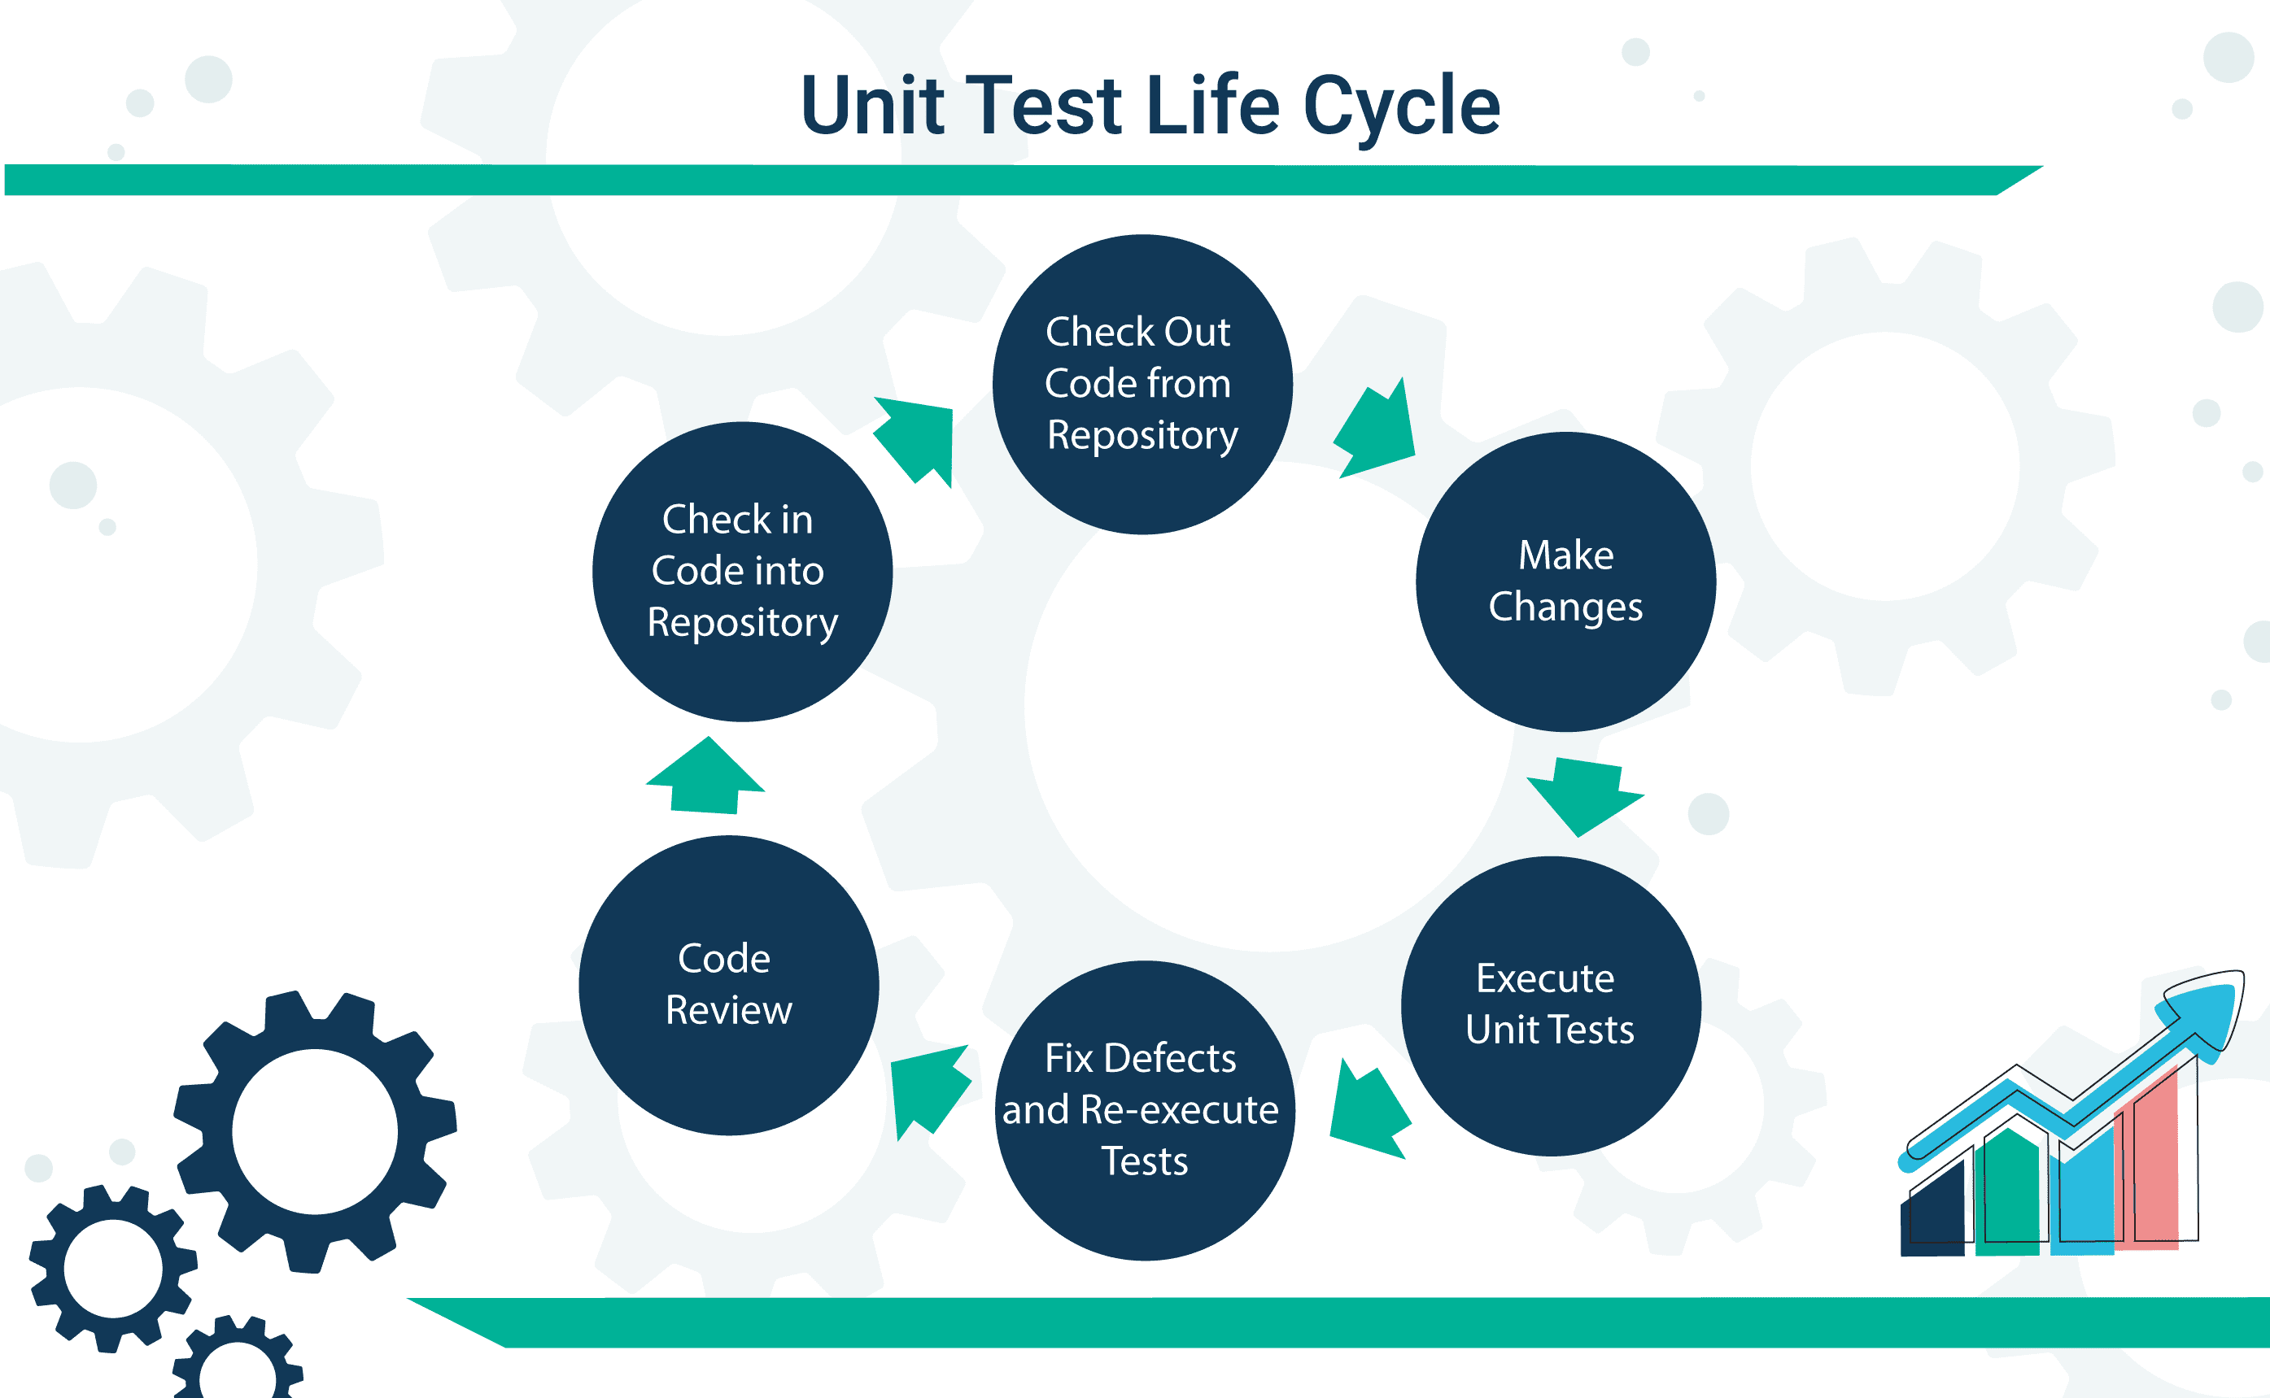
Unit Testing

Slide 11
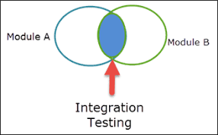
Integration Testing

Slide 12
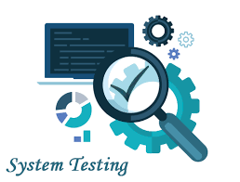
System Testing

Slide 13
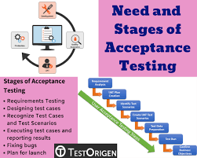
Acceptance Testing

Slide 14
Thank You

